Slide 1
Fundatment of computer
RITIK RAUSHAN

Slide 2
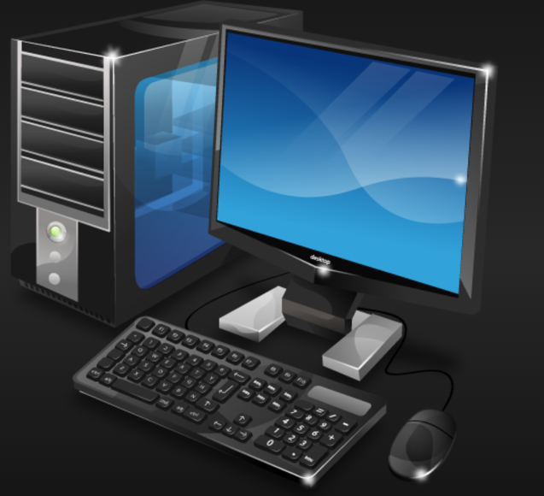
What is computer
A computer is a programmable electronic
device that accepts raw data as input and processes it with a set of instructions (a program) to produce the result as output.
It renders output just after performing mathematical and logical operations and can save the output for future use.
It can process numerical as well as non-numerical calculations. The term
"computer" is derived from the Latin word "computare" which means to calculate.

Slide 3
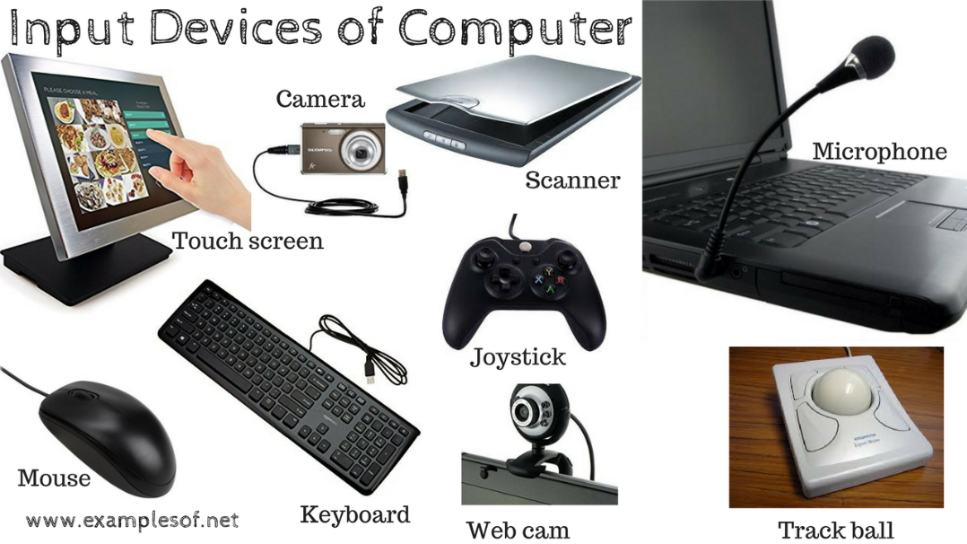
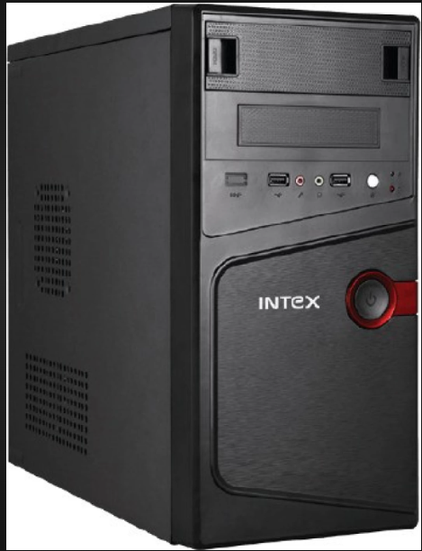
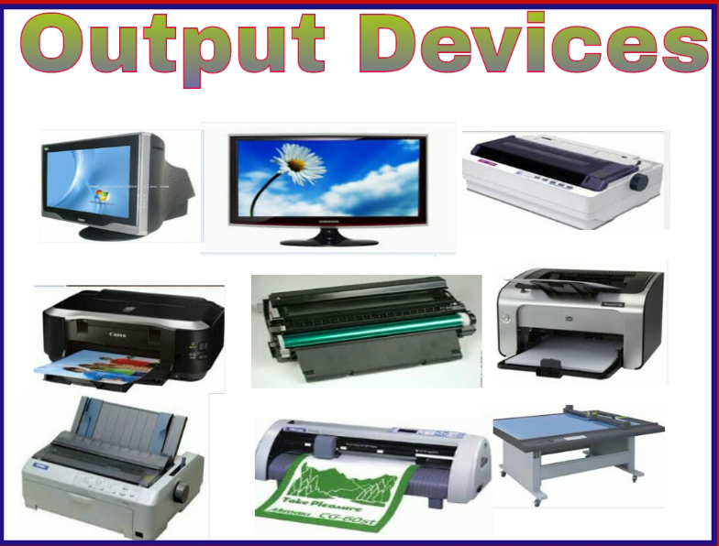
There are three part of computer
Output device
Input device
CPU

